Slide 1

IILM CET GREATER NOIDA
PRESENTATION OF MINI PROJECT
TAPPY CHICKEN
By – Abhishek Raj
Anant Pratap Singh
Pooja Tripathi
Under the supervision of -
Mr. Vikash Singh

Slide 2
ABOUT PROJECT
Tappy Chicken Game project is written completely in Python. All the playing methods are too simple just. All you have to do is just try to stay in the middle of the screen while long pipes keep appearing in front of you. Here, the user has to control the bird by flapping up, down using Spacebar, without touching pipes in order to score game points.

Slide 3
How you can run this GAME
In order to run the game, you must have installed Python 3 and Pygame library on your PC. This is a simple GUI Based game written for the beginners. Tappy Chicken bird Game in Python project with source code can be downloaded from the below mentioned github repository link.👇🏻
https://github.com/iamraj45/TappyChicken

Slide 4
THE APPROACH
Tappy chicken is a continuous and dynamic game. We found that there are 3 elements that are most important to describe the current state of the chicken.
❖ Vertical distance from the lower pipe.
❖ Horizontal distance from the lower pipe.
❖ Chicken's velocity.

Slide 5
ADDING AUDIO & SPRITES TO THE GAME
While playing the game, if the chicken flaps up or down or hits the pipe or ground ,specific sound is played for each movement.
There are several sprites in the game ,each one of them being created using Adobe Photoshop.

Slide 6
SCORING
While crossing every pipe you will be awarded 1 point.
As the chicken collides with the pipe or ground/sky the game gets over.

Slide 7
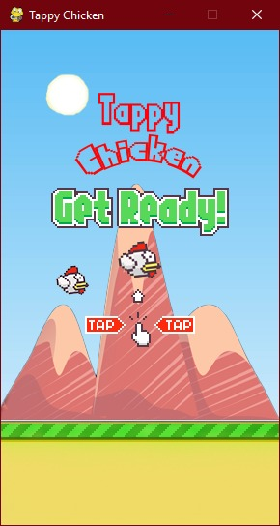
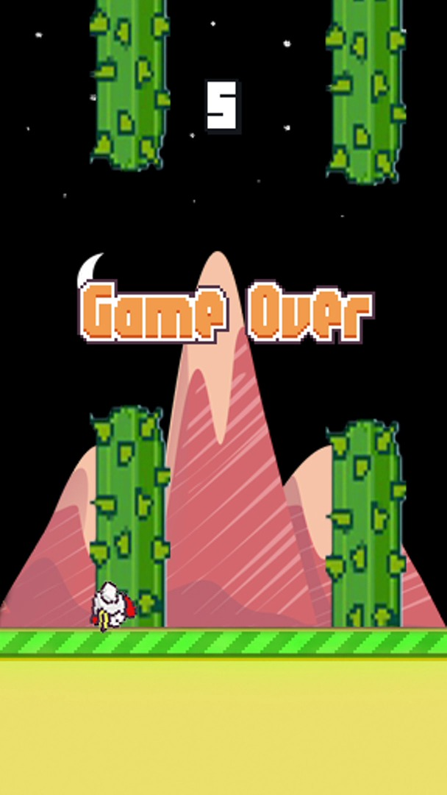

Slide 8
Thank You

